Slide 1
Power-BI
Nikhitha k
1541
Data analytics dept

Slide 2
INDEX
Introduction
Why Power-BI?
Pros & Cons
Real world Application
Dashboard
Conclusion

Slide 3
Introduction
Power BI was first introduced by Microsoft in 2013, It is a powerful suite of business analytics tools developed by Microsoft, designed to help organizations visualize their data, share insights, and make informed decisions.
It allows users to transform raw data from various sources into interactive reports and dashboards that can be easily shared and consumed by stakeholders.

Slide 4
Why Power-BI?
Better for Large Datasets: Power BI handles millions of rows of data efficiently, while Excel can struggle with large datasets, leading to slower performance or crashes.
Interactive Reports and Dashboards: Power BI allows for interactive, dynamic reports and dashboards, where users can filter, drill down, and explore data in real-time. Excel’s charts and pivot tables are more static and less interactive.
Better Data Integration: Power BI connects seamlessly to multiple data sources (databases, cloud services, APIs, etc.) and integrates them in one place, whereas Excel can be more limited in connecting to multiple live data sources at once.

Slide 5
Pros & Cons
Pros | Cons
Handles large dataset | Steeper for beginners
Interactive and advanced Visualizations | Requires internet connection for accessing full features
Real time Collaborations & sharing | Premium features requires subscription
Automatic data refresh | Some features are complex to set up

Slide 6
Real-world Applications
Financial Reporting: Create real-time financial dashboards, and support budgeting and forecasting.
Healthcare: Monitor patient care, hospital performance, and clinical data.
Human Resources: Track employee performance, and plan workforce needs.
Retail: Analyze customer behavior, store performance, and inventory.
Project Management: Monitor project progress, timelines, and operational efficiency.

Slide 7
DASHBOARD

Slide 8
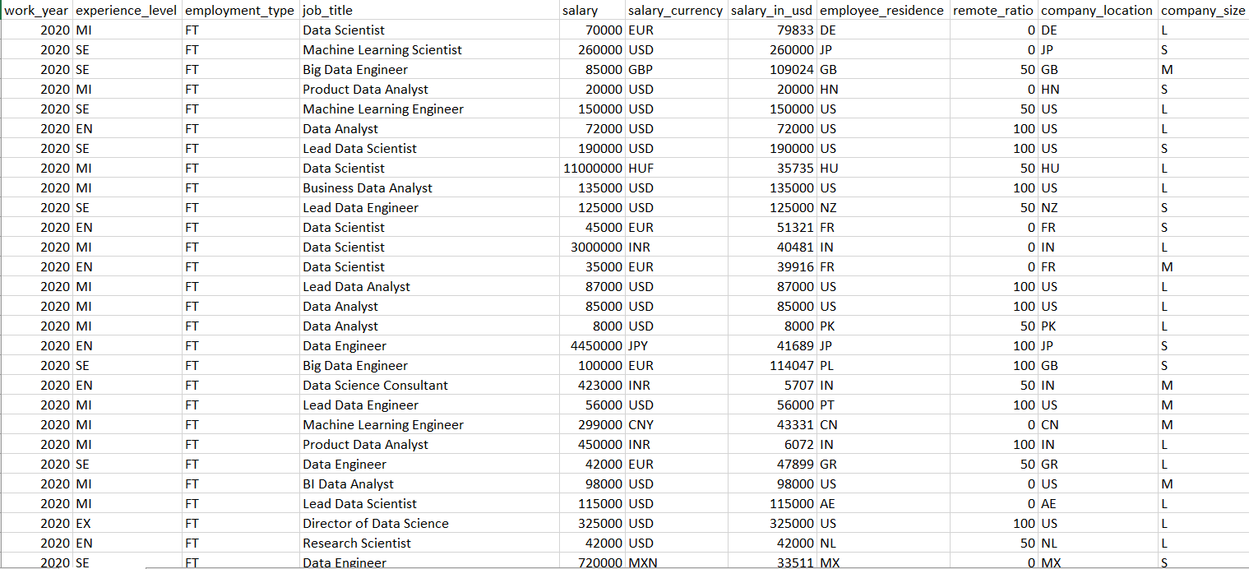

Slide 9
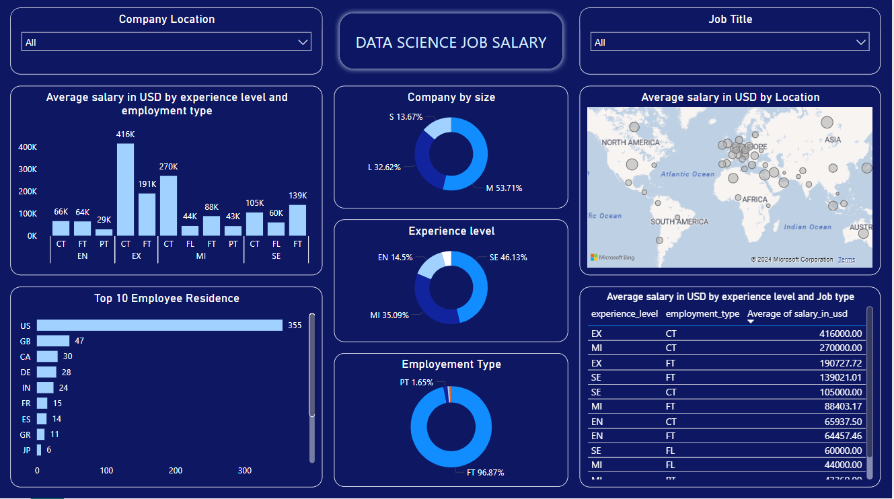

Slide 10
Key Insights
- The highest average salary is observed for Executive-level professionals (EX) working in contract (CT) type roles.
- Full-time (FT) roles dominate the employment type, with a small percentage in part-time (PT) roles.
- The USA has the highest number of data science employees, followed by the UK and Canada.

Slide 11
Conclusion
In conclusion, we've explored how Power BI can transform the way we visualize, analyze, and interact with data.
By leveraging its user-friendly interface, powerful features, and seamless integrations, Power BI empowers organizations to make data-driven decisions with confidence.

Slide 12
THANK YOU

